Slide 1
Hotel booking-cancellation prediction
Nishant 11910329
Pratyush Pranjal 11906033

Slide 2
WHY this project
Huge industry like Hotel Business suffers loss because of frequent cancellations.
Revenue Loss
Operational Problems
Leads to bad reviews
Ultimately affects the overall industry.

Slide 3
Problem statement
Perform exploratory data analysis on the given dataset
Use Machine learning algorithms to build model assisting in booking cancellation

Slide 4
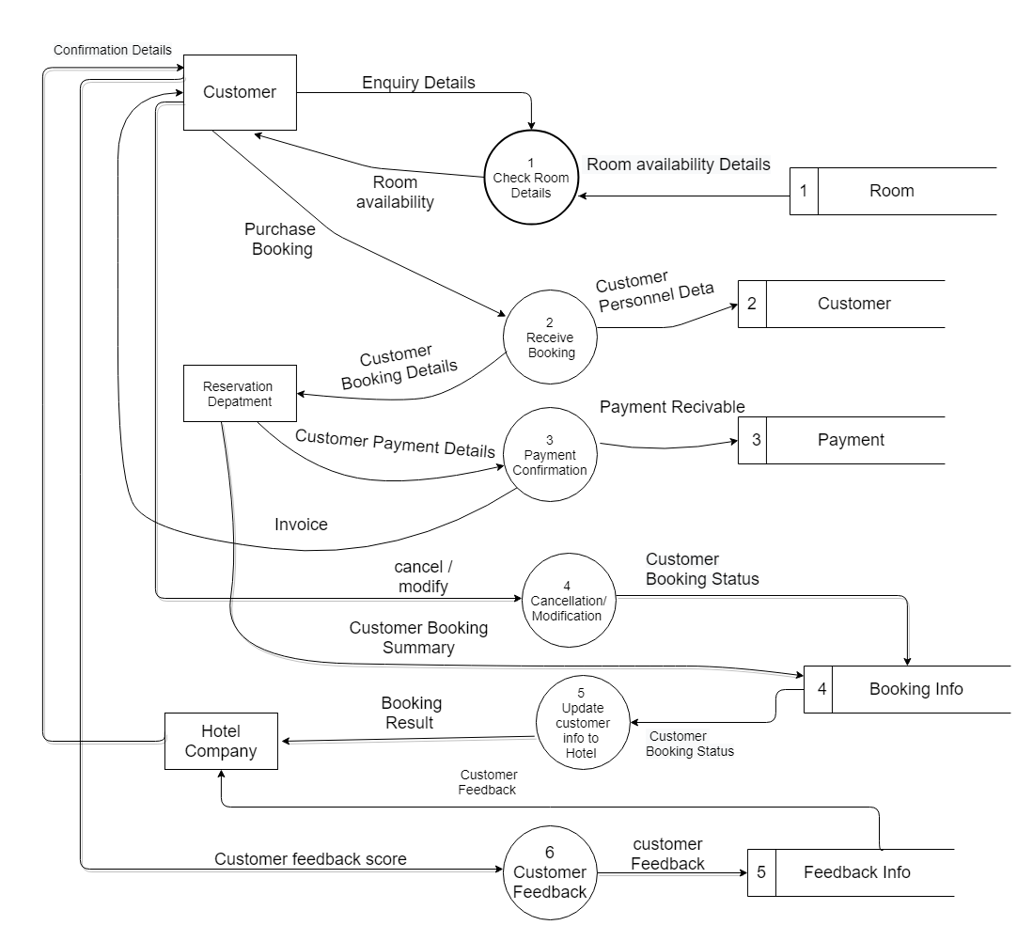
Actual system:
The DFD represents the current flow of data in the system prevalent now.

Slide 5
ML Algorithms:
Target Variable is of Binary type, i.e., Cancellation={0,1}, we need a classification model.
Multiple Classifiers available, the ones we have selected are:
Logistic Regression
Naïve Bayes
Random Forest
Decision Tree
KNN
SVM

Slide 6
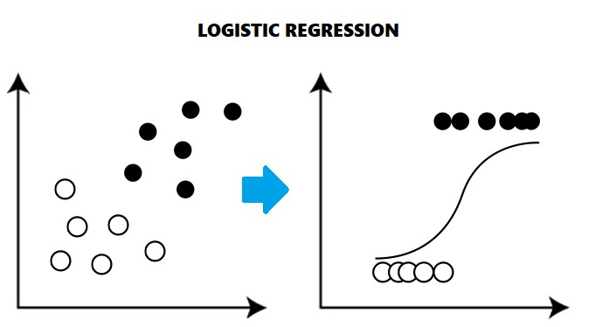
Logistic Regression:
The logistic model (or logit model) is used to model the probability of a certain class or event existing such as pass/fail, win/lose, alive/dead or healthy/sick. This can be extended to model several classes of events such as determining whether an image contains a cat, dog, lion, etc. Each object being detected in the image would be assigned a probability between 0 and 1, with a sum of one.

Slide 7
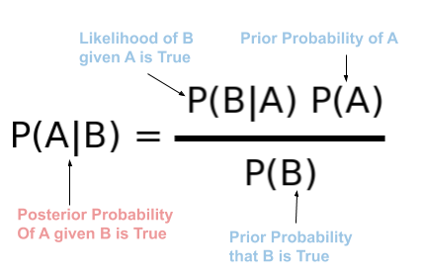
Naïve bayes:
Naive Bayes is a term that is collectively used for classification algorithms that are based on Bayes Theorem. For uninitiated, classification algorithms are those algorithms that are used to categorize a new observation into predefined classes.

Slide 8
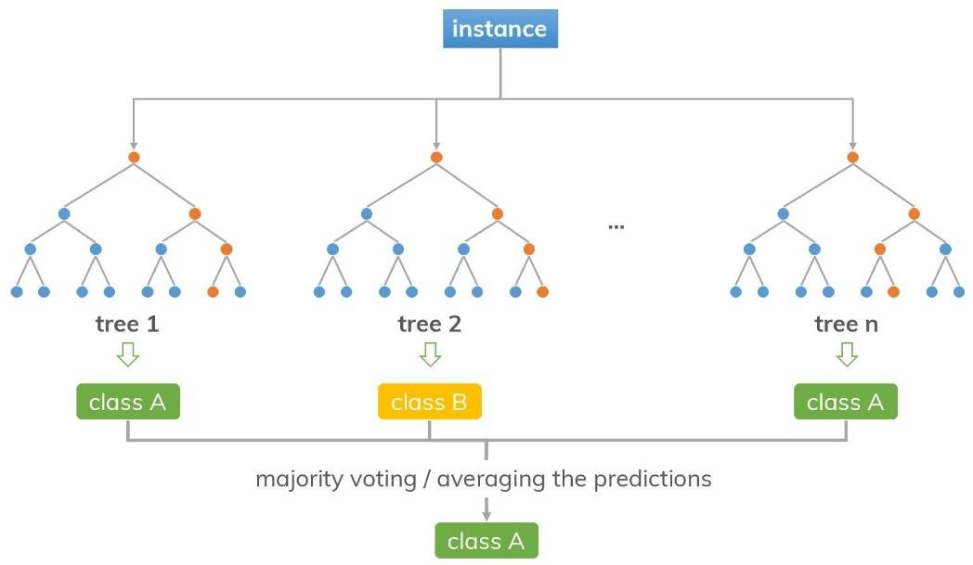
Random forest:
Random Forest is a popular machine learning algorithm that belongs to the supervised learning technique. It can be used for both Classification and Regression problems in ML. It is based on the concept of ensemble learning, which is a process of combining multiple classifiers to solve a complex problem and to improve the performance of the model.

Slide 9
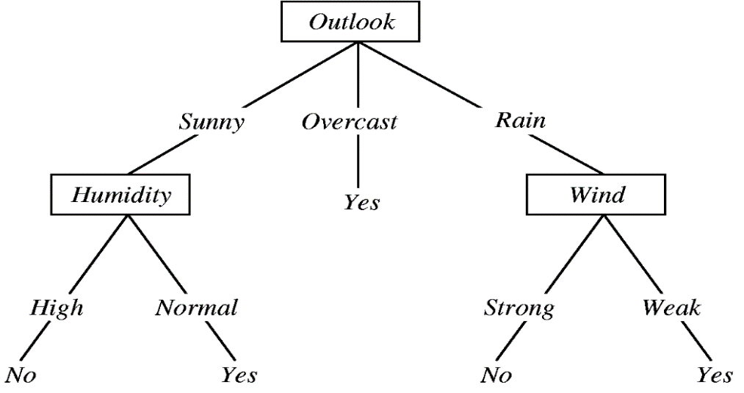
Decision tree:
A decision tree is a flowchart-like structure in which each internal node represents a test on a feature (e.g. whether a coin flip comes up heads or tails) , each leaf node represents a class label (decision taken after computing all features) and branches represent conjunctions of features that lead to those class labels. The paths from root to leaf represent classification rules.

Slide 10
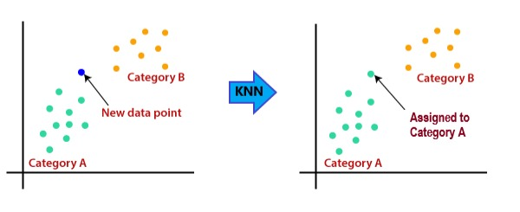
KNN:
K-Nearest Neighbors (KNN) is one of the simplest algorithms used in Machine Learning for regression and classification problem. KNN algorithms use data and classify new data points based on similarity measures (e.g. distance function). Classification is done by a majority vote to its neighbors. The data is assigned to the class which has the nearest neighbors. As you increase the number of nearest neighbors, the value of k, accuracy might increase.

Slide 11

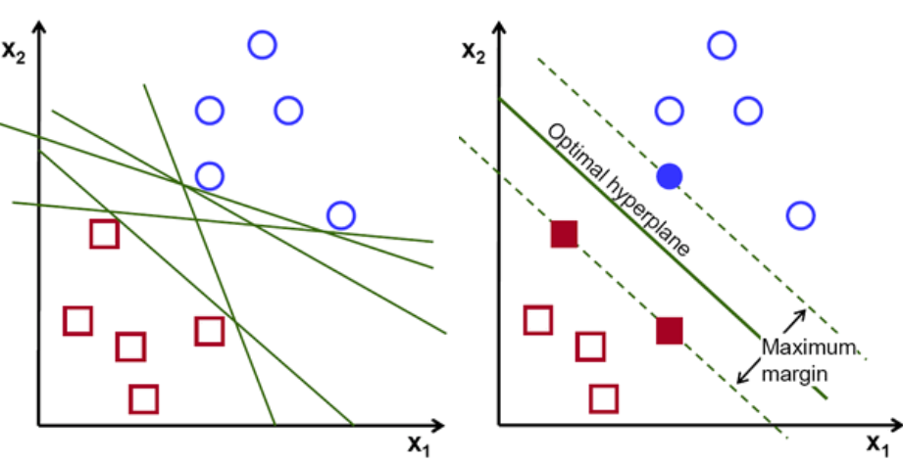
Support vector machine:
Support Vector Machine(SVM) is a supervised machine learning algorithm that can be used for both classification or regression challenges. However, it is mostly used in classification problems. In the SVM algorithm, we plot each data item as a point in n-dimensional space (where n is a number of features you have) with the value of each feature being the value of a particular coordinate. Then, we perform classification by finding the hyper-plane that differentiates the two classes very well.

Slide 12
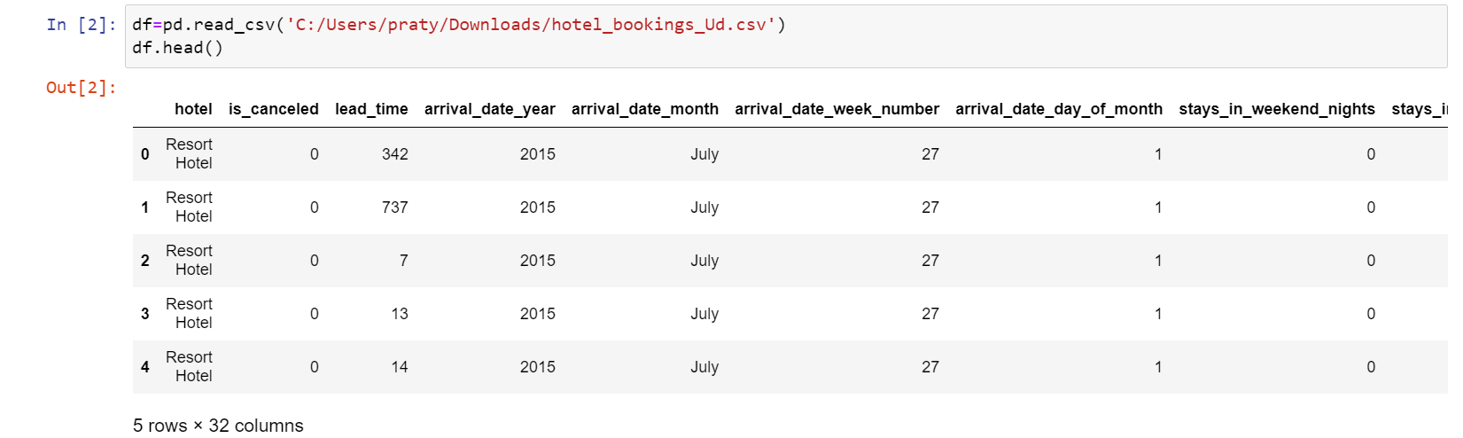
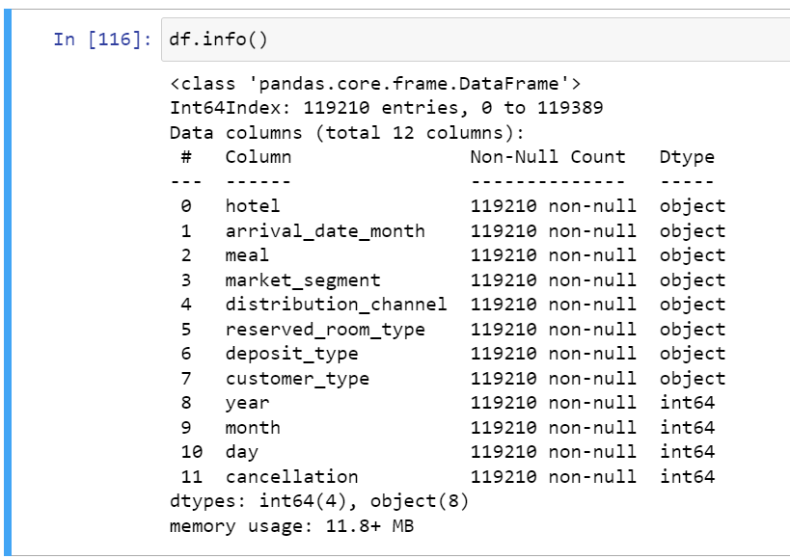
Data information

Slide 13
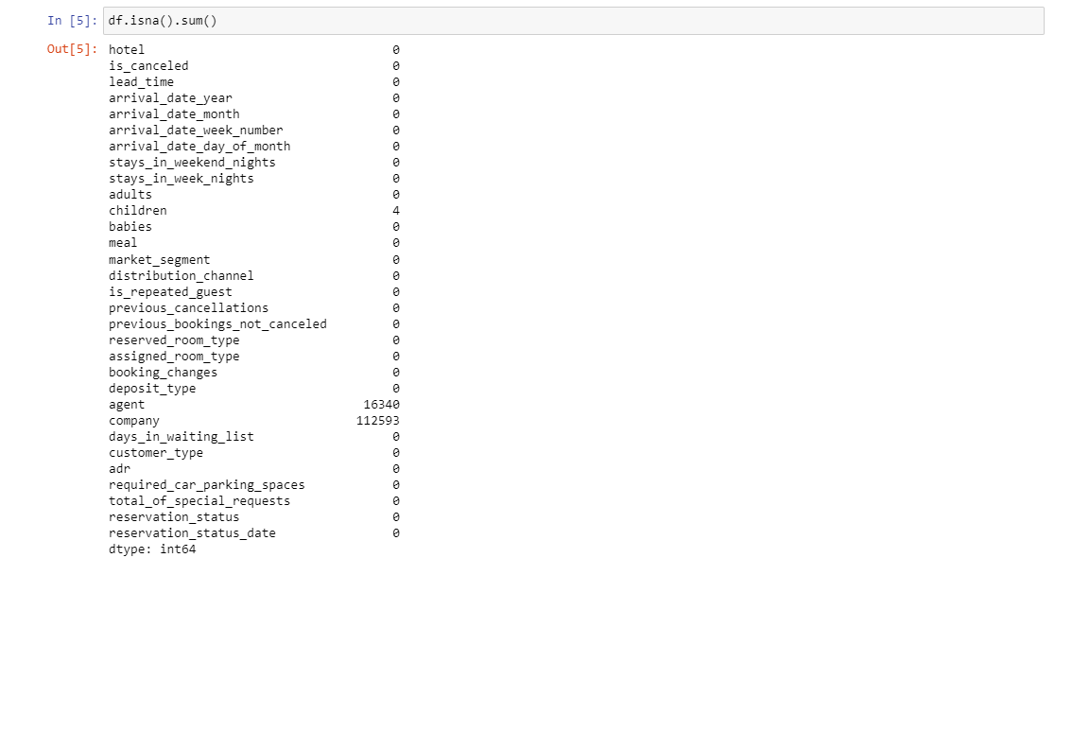
Data cleaning:
Calculating sum of null values
Removing redundant data
Performing EDA

Slide 14
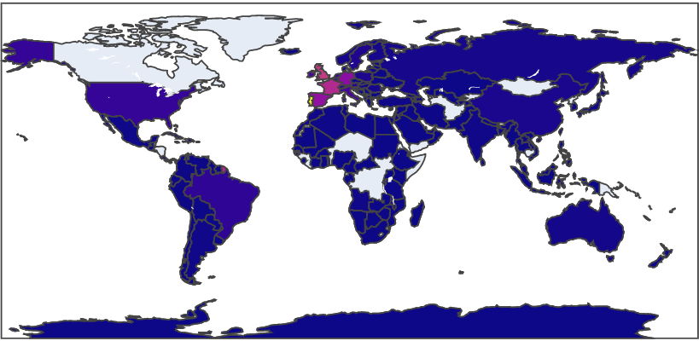
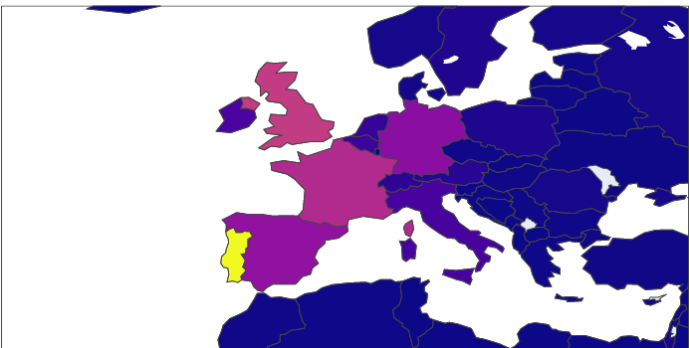
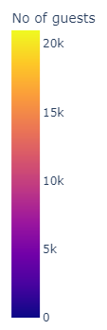
EDA Begins:
Multiple Pattern and Trends were recognized by answer few questions like:
Home countries of the guests

Slide 15
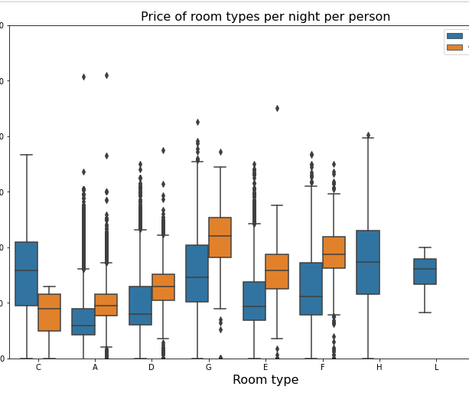
Prices of room per night per person

Slide 16
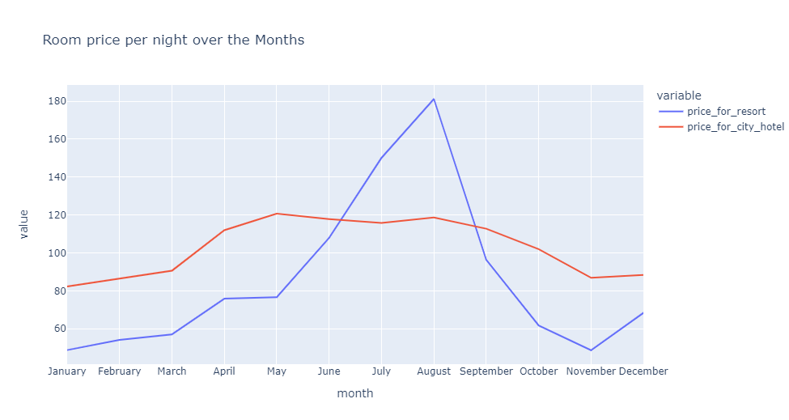
Room Price per night over the months

Slide 17
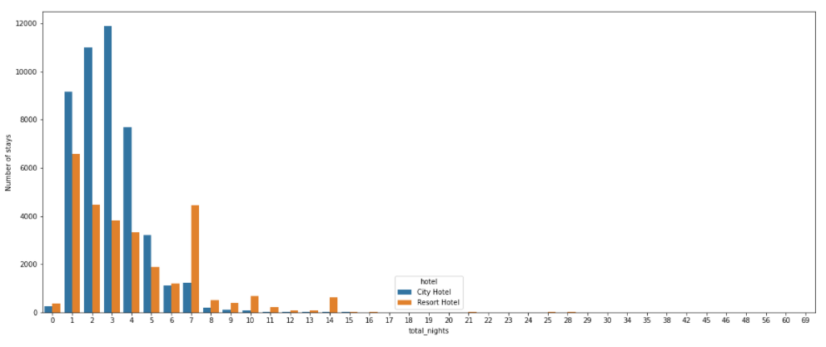
Total number of nights compared with total number of stays

Slide 18
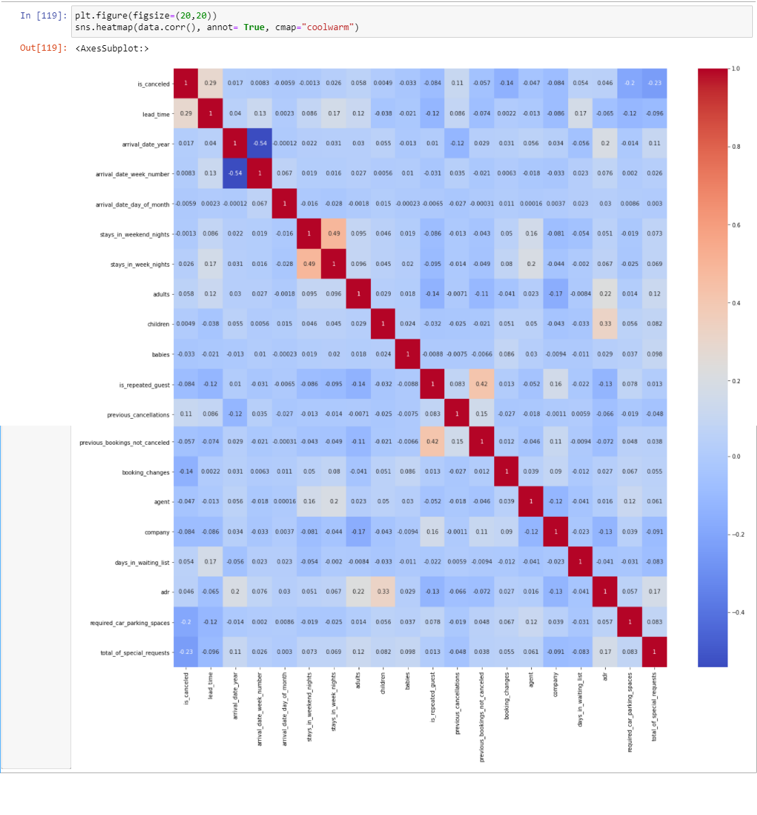
Correlation:

Slide 19
Result analysis:

Slide 20
Application of the project:
Restaurant Booking System
Travel Industry
Health Industry

Slide 21
Future work:
We know that this project only concerns with predicting information on the basis of the dataset that we have at our end, which is actually dated to 2015 to 2017. There are a lot of factors that have not yet been included in this dataset. So, real-time dataset would definitely help the hotel industry or the organization using this model. In addition, we can also say that this model has been made for machine learning enthusiasts. We are yet far from creating this for proper public use. Therefore, with the use of different software like HTML, CSS and JavaScript or Flask or Django, we can create a web UI for the same and avail the services publicly.

Slide 22
Thank you

